Slide 1
Don’t care, Function realization from Truth Table

Slide 2
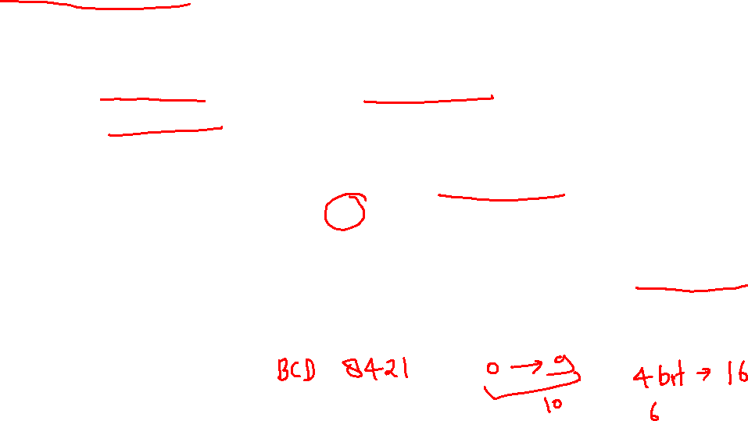
Don't Cares in K-Maps
Sometimes a function table or map contains entries for which it is known:
the input values for the minterm will never occur, or
The output value for the minterm is not used
In these cases, the output value need not be defined
Instead, the output value is defined as a “don't care”
By placing “don't cares” ( an “x” entry) in the function table or map, the cost of the logic circuit may be lowered.
Example 1: A logic function having the binary codes for the BCD digits as its inputs. Only the codes for 0 through 9 are used. The six codes, 1010 through 1111 never occur, so the output values for these codes are “x” to represent “don’t cares.”

Slide 3
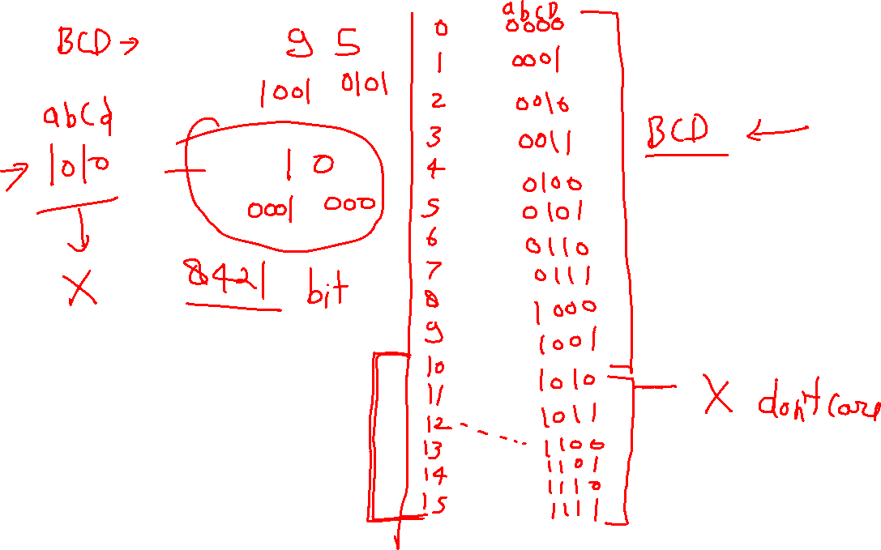

Slide 4
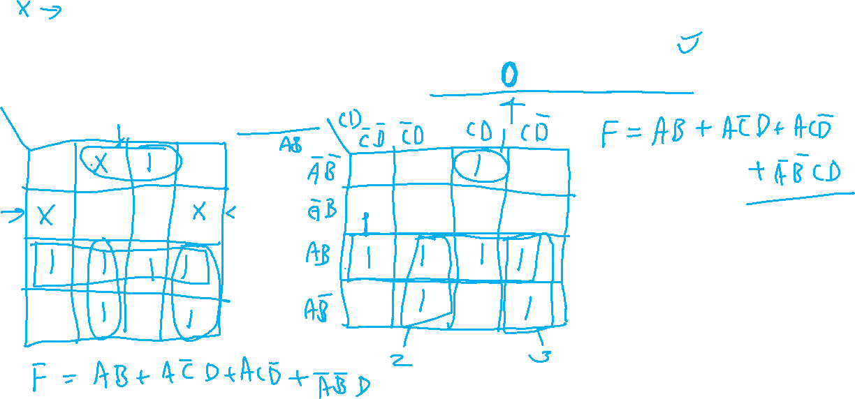
Sums of product Example
Find the optimum solution:
Notes:
F' = B' D' + A' B
F = (B + D)(A + B')

Slide 6
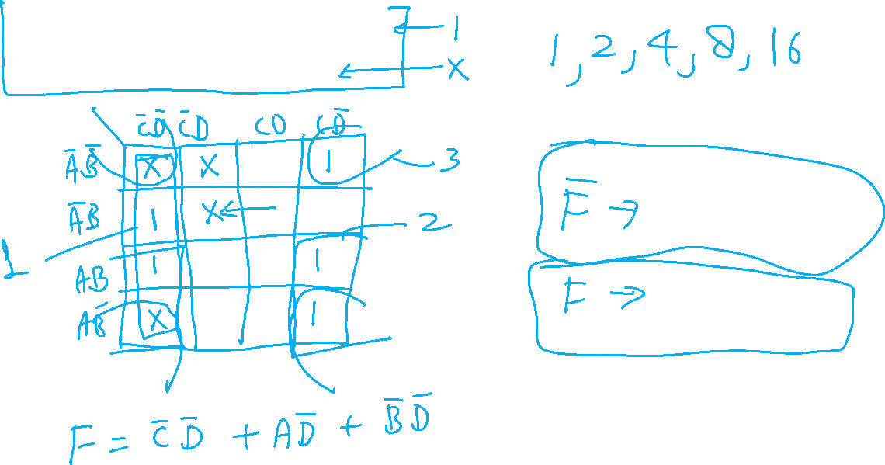
F(A, B, C, D) = (2, 4, 10, 12, 14) d(A, B, C, D) = (0, 1, 5, 8)

Slide 7
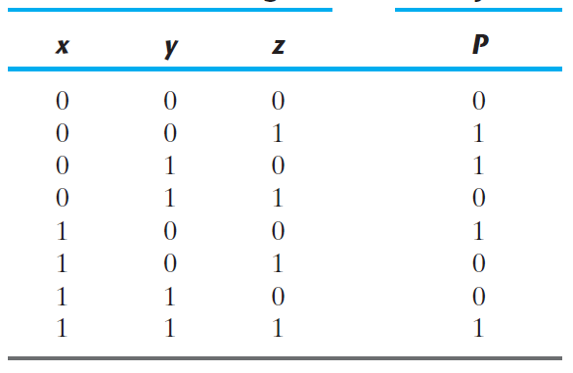
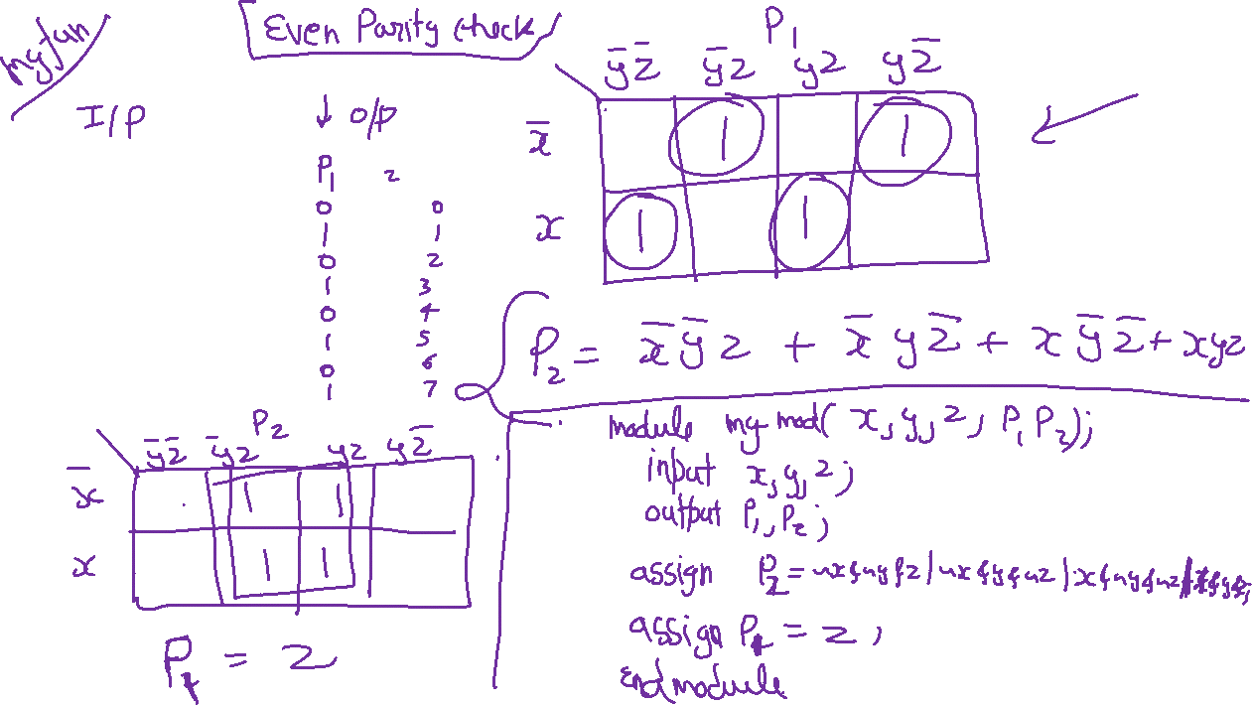
Function realization-

Slide 8
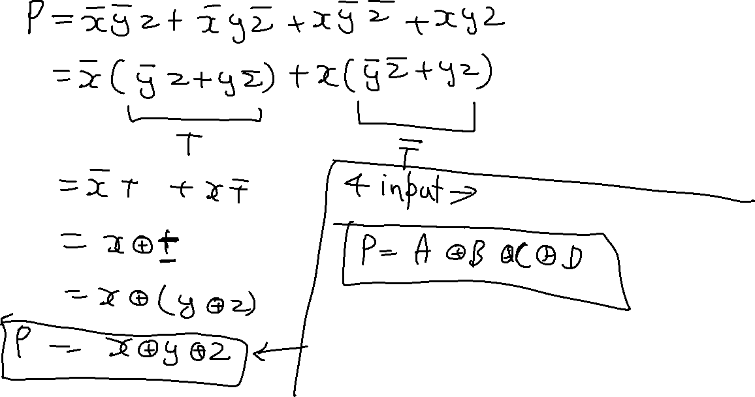

Slide 9
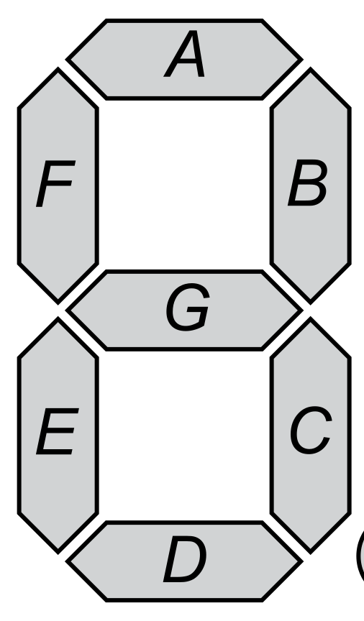
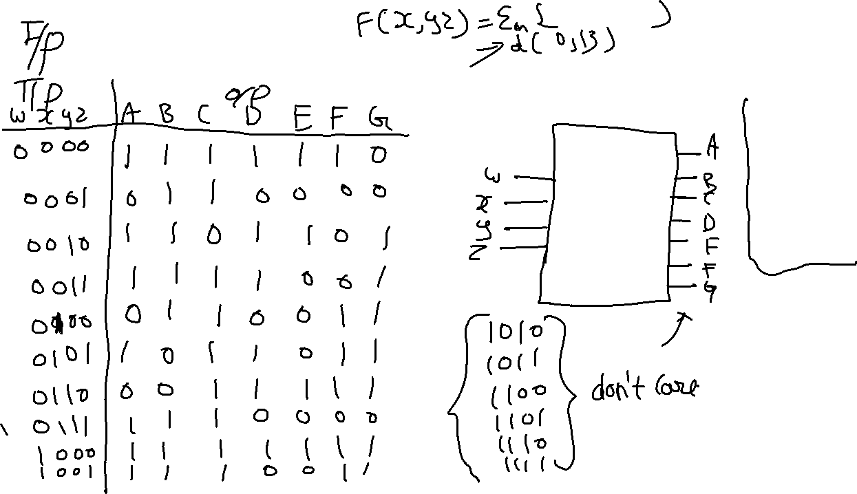
Example of Decimal to 7 segment display

